Slide 1

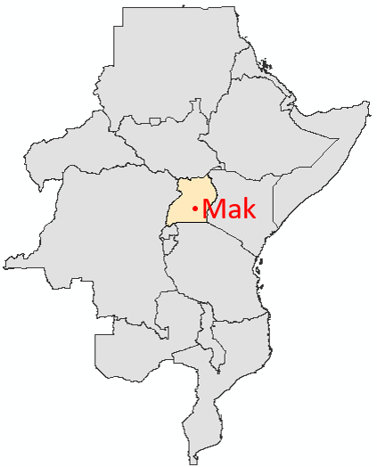


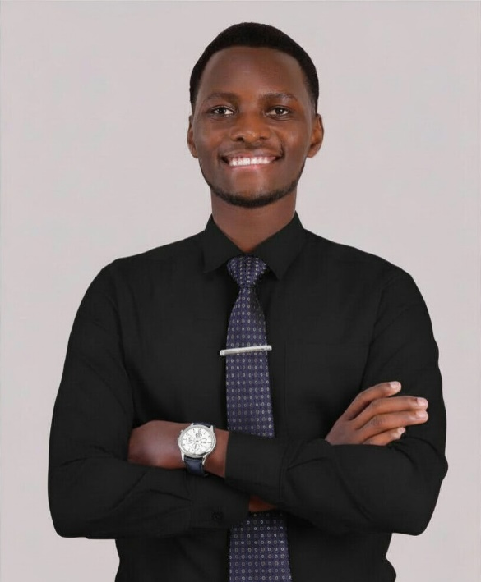
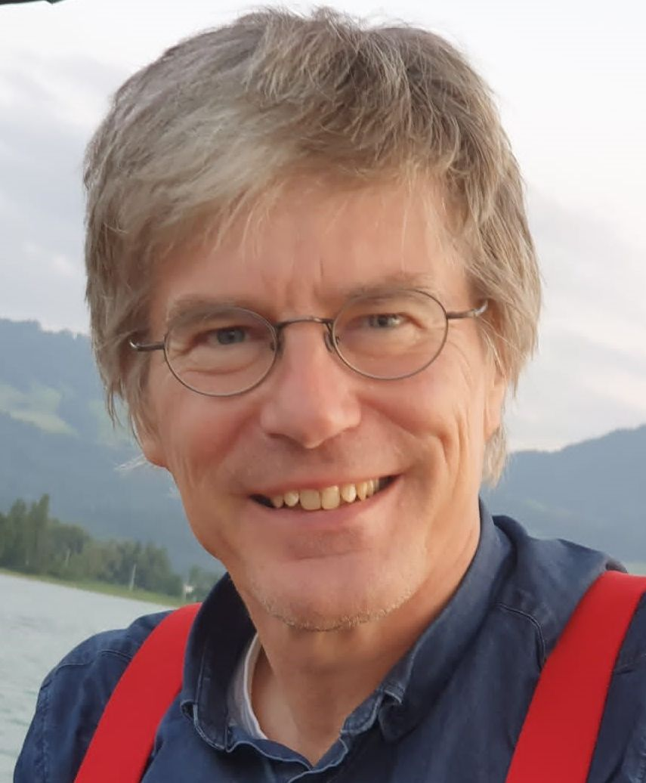
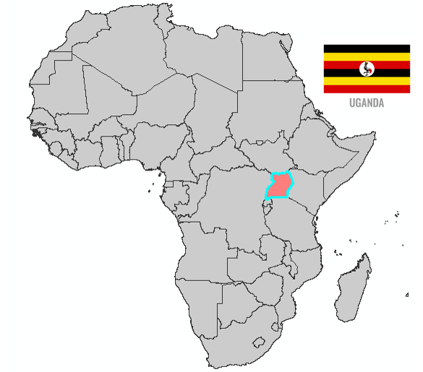




Frank Kiwanuka
University: Makerere University
Study program: Agricultural Engineering
Year of study: 4th year
City: Kampala, Uganda
Motto for life: Stay curious, stay humble
Hobbies: Reading, playing soccer, listening to music, cooking
Your expectations from the summer school:
I want to gain practical knowledge in sustainable technologies and build international connections.
Location where I study,
and where I live
Karlsruhe
31 August to 11 September 2026

